Slide 1
Probability Project Android Application
Group Members
Muhammad Sajid Nazir 15F-8321
Haider Aziz 14f-8124
Ali Haider 15F-8096

Slide 2
Problem Statement !
Information available in raw form
We have to install tools for calculations, charts of data
For statistical calculation there is different tool and for charts you have to install different tool

Slide 3
Solution !
This android app is helpful for statically analysis of data given in raw form and convert it into information.
It will provide you with calculation and charts at the same time in single android application.

Slide 4
Features
Calculations (mean,median,mode,standerd deviation and variance )
Pie chart
Bar chart
Meaningful output

Slide 5


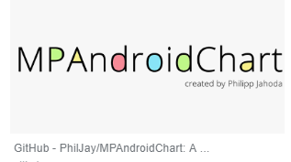
Software and tools

Slide 6
Demonstration!

Slide 7
Thanks!
Any questions?

